Slide 1


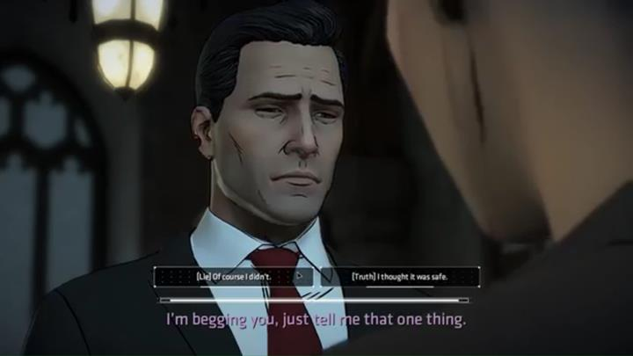
Choose your own adventure
By Dele Tuboku-Metzger and Connor Lokey
This project is inspired by the Telltale games choose your own adventure series where you play as some of your favorite characters from your favorite IPs such as Batman and Star-Lord from Marvel

